Slide 1








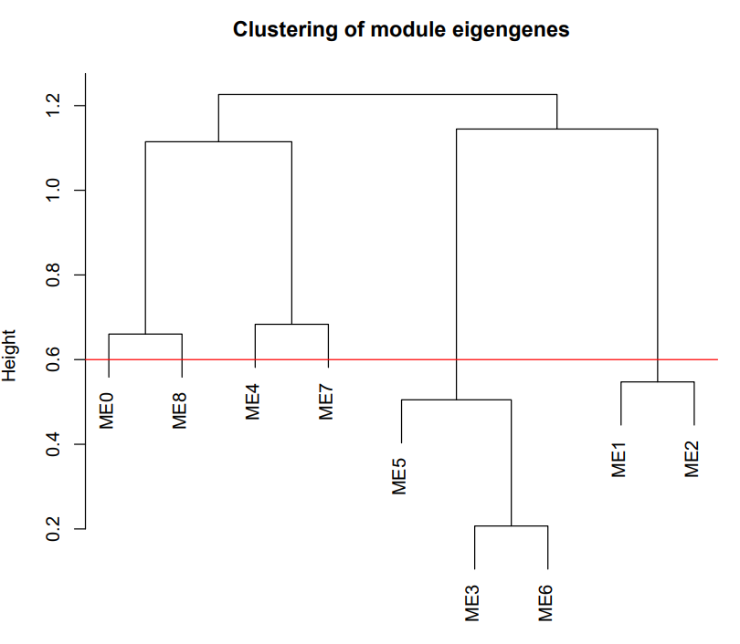
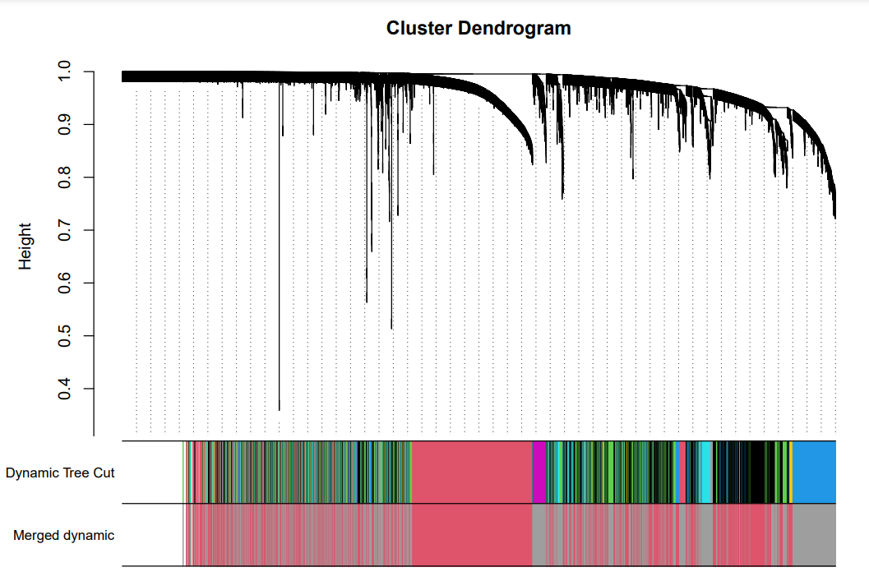
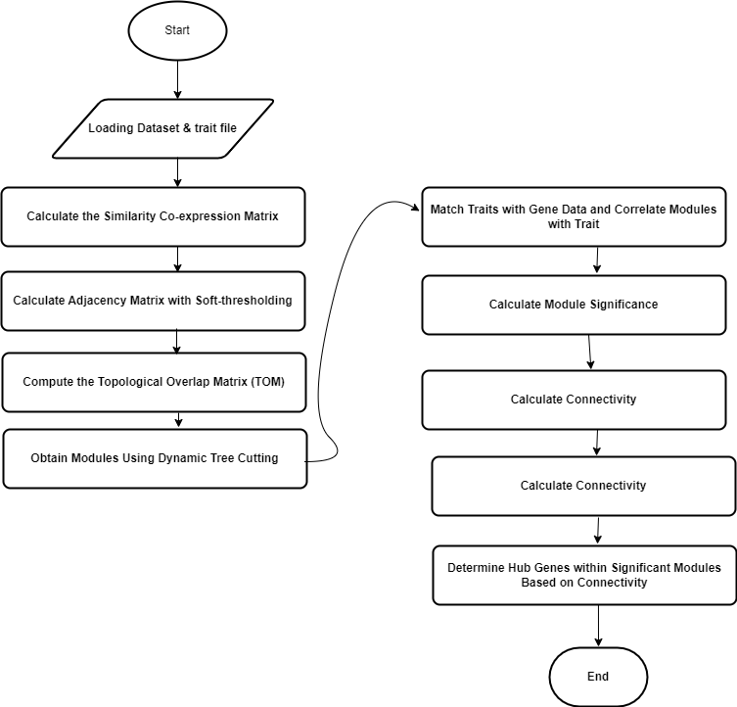
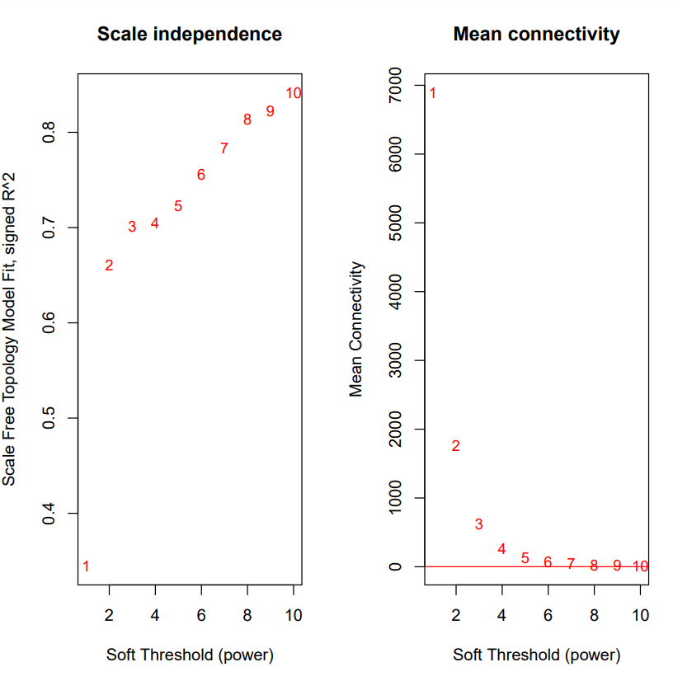
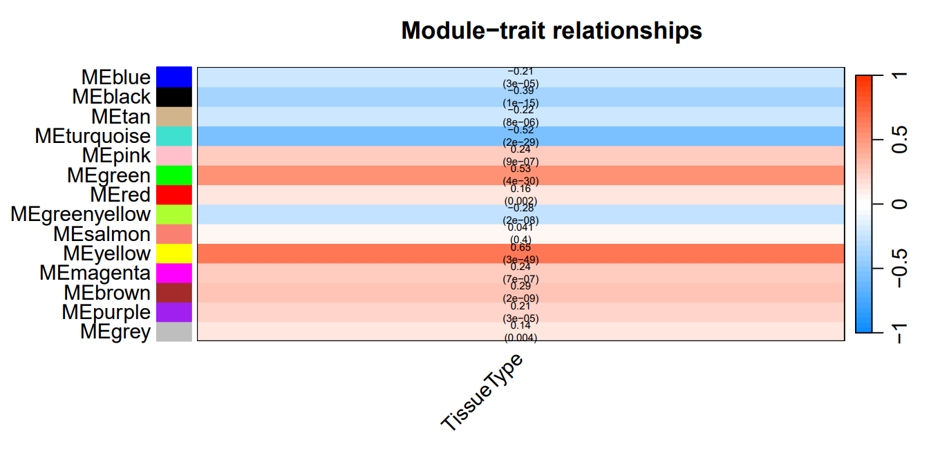
National University of Computer and Emerging Sciences
Identification of Risk Genes for Neurodegenerative Diseases
Supervisor Mr. Shoaib Rauf
Robaisha Masood | Noor Afshan | Hira Tahir
20K-0390 | 20K-0266 | 20K-0374
Abstract
Introduction
The purpose of this research is to focus on Alzheimer's disease, which is a neurodegenerative condition often caused due to progressive dysfunction of neurons. Specifically, this study has unraveled Alzheimer's pathology by gaining insights from the dataset GSE118553 from NCBI GEO DATA. These genes form communities that cause malfunctioning. The Dataset contains brain tissue data from 27 control, 33 AsymAD, and 52 Alzheimer subjects. Checked affected areas (entorhinal, temporal, frontal cortex) and spared tissue (cerebellum). Derived meaningful insights from the raw data. Utilizing the advanced data mining method Weighted Gene Co-expression Network (WGCNA) is used to infer the hub genes and their role in such diseases by using pairwise correlation between genes. Furthermore, this study has exploited Machine Learning algorithms to validate our results ensuring accuracy and effectiveness.
Overall, our research has uncovered novel genes that may be involved in the pathogenesis of Alzheimer's offering prospects in recognition of AD biomarkers and therapeutic targets. The study discovers the application of Machine Learning algorithms within the domain of bioinformatics. This discovery will facilitate the scientific community to produce more efficacious treatments for neurodegenerative disorders.
Neurodegenerative diseases are chronic brain conditions when the neurons start to degenerate gradually due to abnormal accumulation and misfolding of specific proteins. Neurodegenerative diseases cause memory loss and behavioral abnormalities. The degeneration of neurons leads to neuronal damage and causes memory loss in the patient at different stages. Neurodegenerative disease syndrome includes Alzheimer's disease, Parkinson's disease, and Huntington's disease.
Neurodegenerative diseases pose significant challenges, causing a gradual decline in brain function and ultimately leading to neuronal death. Among these conditions, Alzheimer's disease (AD) stands as a prominent example, affecting millions globally.
Recent research in the domain of neuroscience has discovered some factors that potentially cause the pathogenesis of neurodegenerative disease, especially Alzheimer's. One of the research hypotheses suggests that the mental levels of deregulation in the brain may play a very vital role in the development of neurodegenerative disorders. This hypothesis is supported by the observation of amyloid aggregation and oxidative stress, both of which are pathological factors associated with the disease. To further investigate the matter, our study will focus on identifying the genes working together that govern the pathogenesis of the disease.
Our study focuses on leveraging such tools to investigate the genetic basis of Alzheimer's disease, especially by examining the GSE118553 dataset. This dataset contains genetic information from brain samples of healthy individuals, those with early-stage AD that is AsymAD, and those diagnosed with Alzheimer's.
Our approach employs Weighted Gene Co-expression Network Analysis (WGCNA).To ensure the reliability of our findings, we also utilize machine learning algorithms. By integrating these methods, our research aims to deepen our understanding of Alzheimer's disease, identify potential biomarkers for early diagnosis, and uncover new therapeutic targets.
Information Of GSE118553
Sample Source | AD | Control | AsymD
Temporal Cortex(TC) | 52 | 31 | 32
Frontol Cortex(FC) | 40 | 23 | 33
Entorhinal Cortex(EC) | 37 | 24 | 37
Cerebellum(CE) | 38 | 22 | 32
Table 1. Information of GSE118553
References
[1] Y. Lagisetty et al., “Identification of risk genes for Alzheimer’s disease by gene embedding,” Cell Genomics, vol. 2, no. 9, p. 100162, Sep. 2022, doi: 10.1016/j.xgen.2022.100162.
[2] J. J. Palop, J. Chin, and L. Mucke, “A network dysfunction perspective on neurodegenerative diseases,” Nature, vol. 443, no. 7113, pp. 768–773, Oct. 2006, doi: 10.1038/nature05289.
[3] G. G. Kovacs, “Concepts and classification of neurodegenerative diseases,” in Handbook of Clinical Neurology, 2018, pp. 301–307. doi: 10.1016/b978-0-12-802395-2.00021-3.
[4] M. A. Myszczynska et al., “Applications of machine learning to diagnosis and treatment of neurodegenerative diseases,” Nature Reviews Neurology, vol. 16, no. 8, pp. 440–456, Jul. 2020, doi: 10.1038/s41582-020-0377-8.
[5] W. Mandemakers, V. A. Morais, and B. De Strooper, “A cell biological perspective on mitochondrial dysfunction in Parkinson disease and other neurodegenerative diseases,” Journal of Cell Science, vol. 120, no. 10, pp. 1707–1716, May 2007, doi: 10.1242/jcs.03443.
Technologies
Google Collaboratory
Results
Methodology

